Slide 1
Homework Set – 03: Solution
1. Let S be a set of n disjoint line segments in the plane, and let p be a point not on any of the line segments of S. We wish to determine all line segments of S that p can see, that is, all line segments of S that contain some point q so that the open segment pq does not intersect any line segment of S. Give an O(nlogn) time algorithm for solving this problem. See the example shown in the figure. [5]
Solution: Imagine a circle C with centre at p that encloses all the points. Shoot rays from p through segment-end-points and project each line-segment on the boundary of C as an arc. Order the arcs based on the radial distance (from p) so that if segment a is closer to segment b from p, we put arc(a) nearer to p than arc(b) as shown in the figure. Since segments are disjoints, the ordering is unique around C. Sort the end-points of arcs in CCW order angularly w.r.t. p. Clearly, if arc(a) appears closest to p some time during the walk around C, segment a is visible from p.
Identify the segment that is closest to p, and start circular sweep from the end-point of the corresponding arc. Maintain the sweep-line status (ordering of arcs along radial shoots) with a balanced binary tree. Update the status when end-points of arcs are hit. Continue through 360 degree until all end-points of arcs are processed. At each step, output the segment corresponding to the closest arc (from p). Clearly, all work can be completed in
O(n log n) time.
radial order

Slide 2
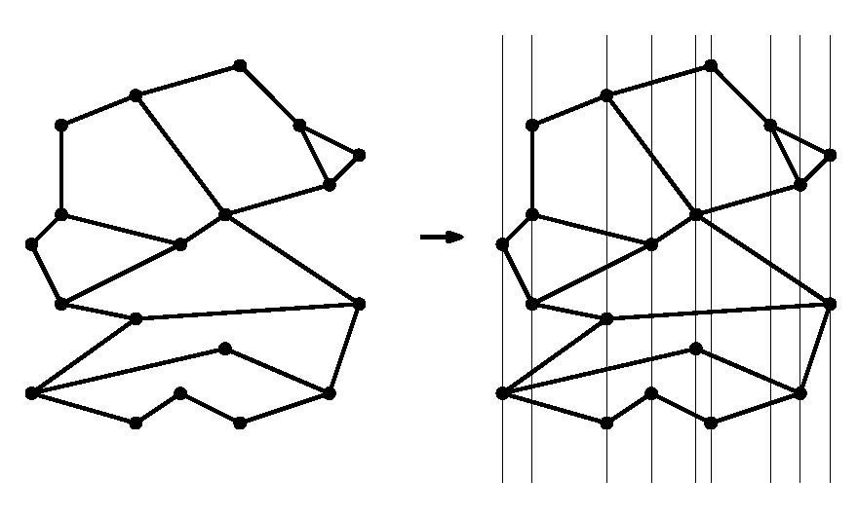
Homework Set – 03: Solution
2. Let S be a subdivision of complexity n, represented using DCEL data structure, and let P be a set of m query points. Give an O((n + m) log(n + m))-time algorithm that computes for every point in P in which face of S it is contained. [5]
Solution: Draw vertical lines passing through each vertex of S and each point in P, and sort them left-to-right based on their x-coordinates. Imagine a vertical sweep-line that moves horizontally stopping at all vertices ∈ S and points ∈ P. Sweep-line status (SLS) is maintained as a balanced binary tree (T) which stores relevant edges of S in vertical order. T is updated for each vertex ∈ S. When a left (right) end-point of an edge e is hit, e is inserted (removed) in (from) T maintaining the edge-order.
p₂
p₁
When a query point p_{i} ∈ P is hit, T is searched to locate the two edges of S that appear just above and below of p_{i}. The face defined by the two edges encloses p_{i} and is reported. If the edge is found only at one side (above or below), then the enclosing face is the exterior one.
Sorting of all vertices in S and points in P takes O(n + m)log(n + m) time;
Update of T requires O(n log n) time using DCEL, over all vertices in S; processing of m query-points needs O(m log n) time in total. For each point p_{i} ∈ P the enclosing face can be identified in O(1) time using DCEL. Hence, overall, we need O(n + m)log(n + m) time;

Slide 3
Homework Set – 03: Solution
3. Write a formal proof for the following claim: Any polygon with h holes and a total of n vertices (including those defining the polygon and holes), can always be guarded by ⌊(n + 2h)/3⌋ vertex guards. Note that a hole may be surrounded by other holes, and thus it may not be always visible from the boundary of the polygon. [5]
Solution: Locate the hole H which is closest to the polygon P, i.e., find a pair (a, b) of vertices a ∈ P and b ∈ H such that dist(a, b) is minimum. Hence, (a, b) must be a mutually visible pair. Add two new vertices (very close to a, b, one each), and two edges so as to combine the contours of P and H into a single simple polygon, as in the figure. Repeat this procedure until all holes and P are all merged to form only a single simple polygon P*. Clearly, P* will have with n + 2h vertices;
P
H
Application of Chvátal’s theorem on P* implies that it can be guarded with
⌊(n + 2h)/3⌋ vertex guards. Since the extra vertices were placed very close to the original corners, the visibility solution in P* also holds for the original problem.

Slide 4
Homework Set – 03: Solution
4. Consider an implementation of Hertel-Melhorn (HM) Algorithm for convex-partitioning of a simple polygon P with n vertices. Assume that a triangulation of P is given. Suggest a data structure and the required procedure so that HM-Algorithm can be implemented in O(n)-time. [5]
d
Solution: Triangulation of an n-vertex polygon yields a planar sub-division of complexity O(n), which can be conveniently represented by DCEL. In HM algorithm, we first determine, for each diagonal, whether or not it is essential. For each diagonal d, this can be checked by looking at the two opposite angles (which are joined by d) of the quadrilateral formed by the two faces separated by d. If d is not essential (i.e., when both the angles are convex), we remove the edge d, and update DCEL; else retain d. If a diagonal is removed, the status of at most four diagonals (whether essential or non-essential) corresponding to the edges of the quadrilateral needs to be updated. We iterate this procedure until the status of all diagonals become essential. In DCEL, each update can be done O(1) time, and since we have (n – 3) diagonals in the triangulation, the HM-procedure for partitioning P into convex pieces can be completed in O(n) time and in O(n) space.

